Slide 1

Dr. Fone
Android & IoS

Slide 2
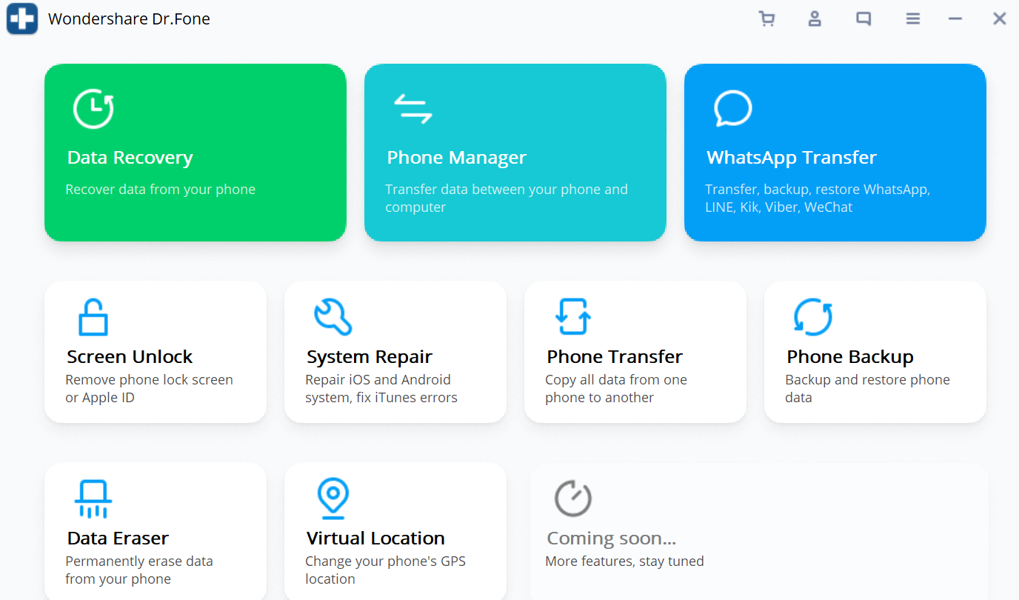
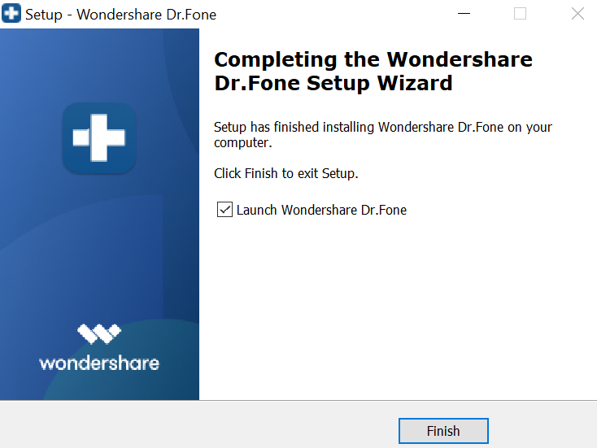
Download & Setup
Download the cracked version on Get Into PC.
Unzip the file with password 123.
Double click on the setup.exe to install the application.
Go in the crack folder and doble click on DrFoneRecovery.exe and launch the application.

